Slide 1

ATMic: Fast 4π tracking based on GPUs and its framework
Akitaka Ariga (Senior staff)
Albert Einshtein Center for Fundamental Physics, Laboratory for High Energy Physics,
University of Bern

Slide 2
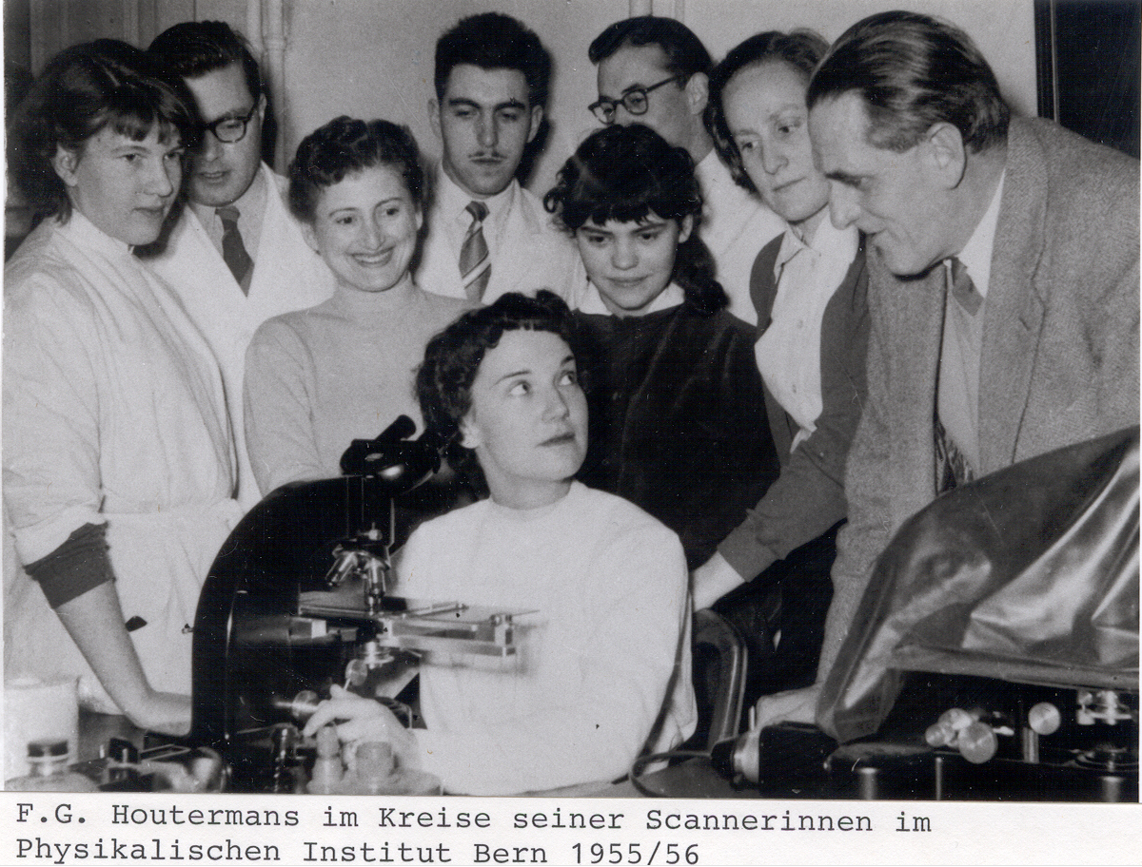

Scanners in Bern some time ago

Slide 3
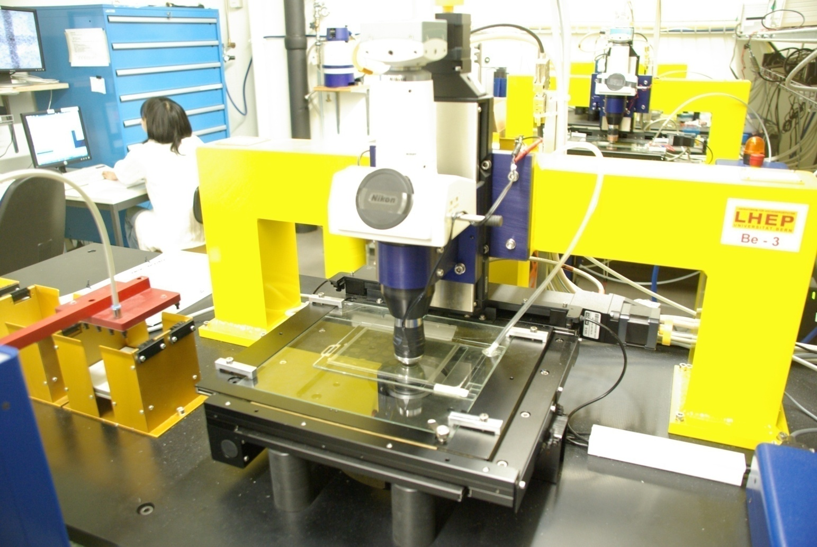
Conventional system : OPERA Microscope
CMOS camera
1280×1024 pixel
256 gray levels
376 frames/sec
(Mikrotron MC1310)
Emulsion film
Z stage (Micos)
0.05 μm nominal
precision
Automatic Plate Changer
XY stage (Micos)
0.1 μm nominal
precision
objective (Dry 50× NA 0.95)
20 min / cm²
3
Notes:
3

Slide 4
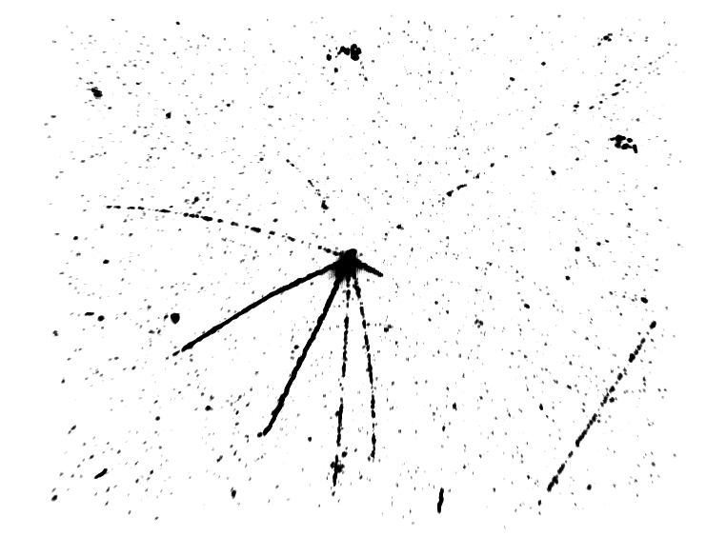
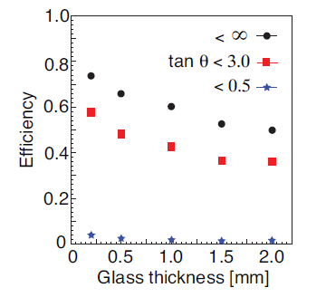
Limitation of conventional system
150 μm x 120 μm x 50 μm
Small angular acceptance
  θ < 0.5
  For AEgIS, we need 4π tracking!
Tracking tuned for penetrating particles
  Limited information can be extracted
  Scattered track cannot be followed
  Short tracks which start and stop in emulsion cannot be detected
Less flexibility
  Development beyond OPERA is difficult
→New Framework : ATMic
Antiproton detection efficiency
OPERA acceptance
emulsion
OK NO NO
Penetrating tracks
θ<0.5
Penetrating tracks
θ>0.5
Short tracks

Slide 5
ATMic
A framework for general purpose scanning
  Data classes
  Stage driver
  Camera interface
  Tracking
  Reconstruction
  Display (Virtual microscope)
  GPU interface
ROOT-base program
OS independent (Windows or Linux)
Microscope
Camera
Stage
Host PC
Camera
I/F
Stage driver
Tracking
GPU
Save

Slide 6
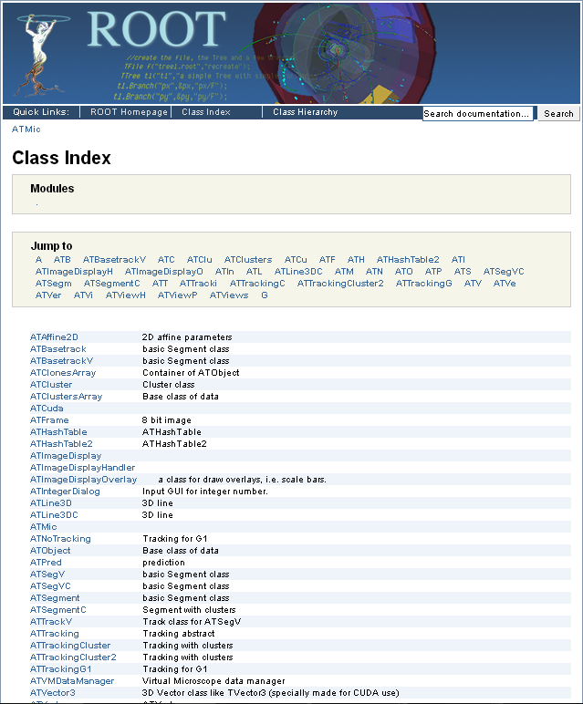
ATMic classes
All classes are ROOT classes
Well documented
  Transparent for users
Capable to accommodate several tracking algorithms

Slide 7
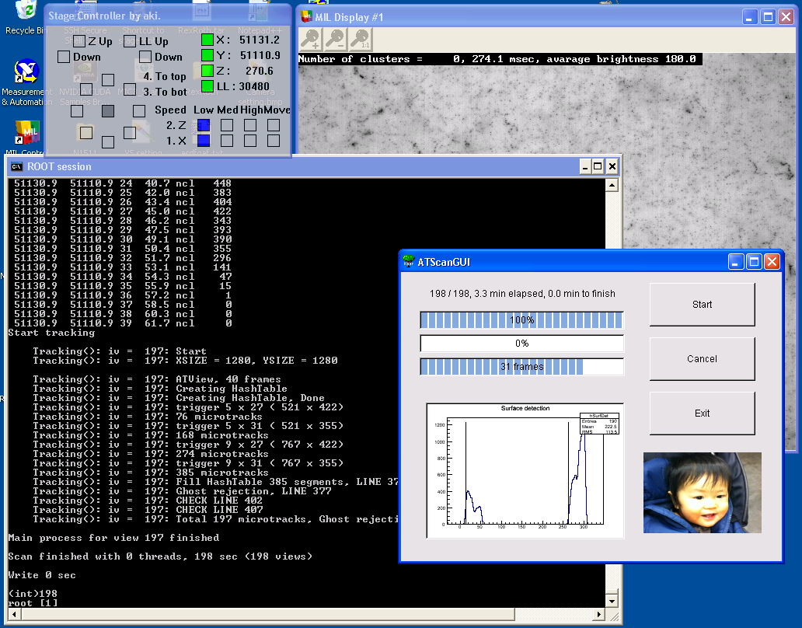

Slide 8
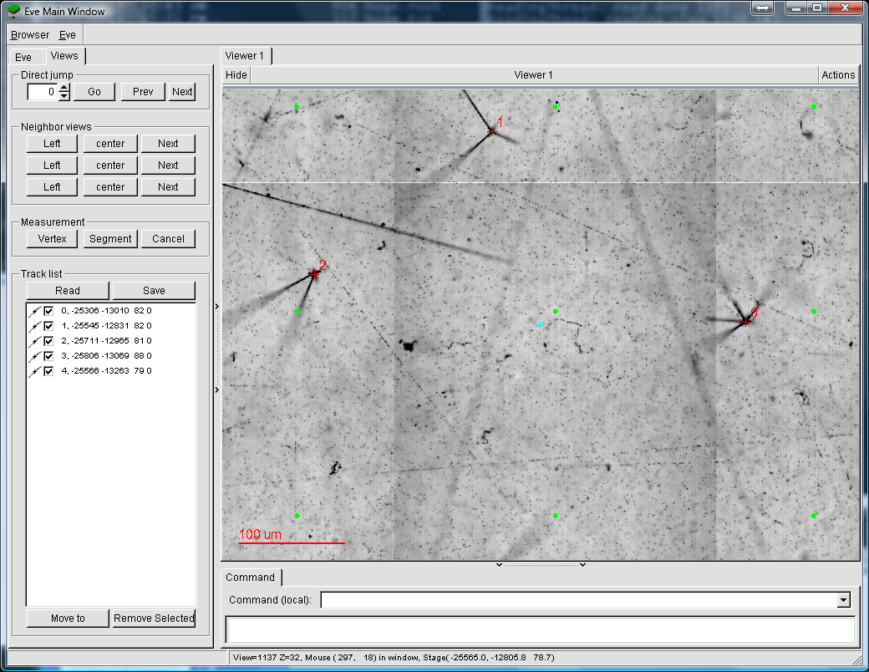
Virtual microscope
ROOT & OpenGL base programming
Dynamic data management
  Necessary to deal Tera-byte scale data
  Multithreads for display / reading data
Nice also for students and general public
  See image display

Slide 9
Fast 4 π tracking
General purpose tracking
  8 times larger angular acceptance in solid angle than OPERA
Detection of short tracks
  finer sampling (16->40 frames/view)
  quick algorithm
  start and stop points information
  >10 times more computing than OPERA
→ 2 order of magnitude larger computation is needed when it is compared OPERA algorithm
 | AEgIS | OPERA
acceptance in θ (rad) | π | 0.5
Acceptance in steradian | 12.6 (4π) | 1.5
emulsion

Slide 10
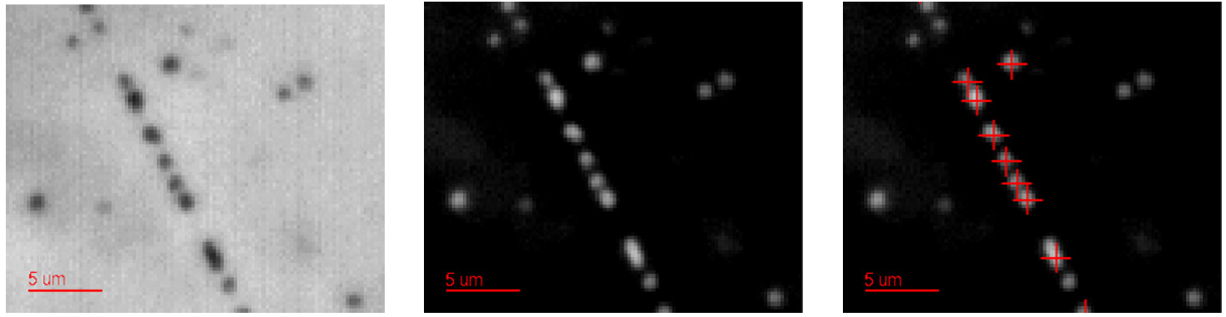
3D Filtering
Pixel by pixel gain control
BG subtraction
3D grain recognition

Slide 11
Tracking algorithm
Find any 2 grains combination within a certain distance, forming seeds (lines).
Count number of clusters along the lines. if number of clusters is bigger than a threshold, classify as a track.

Slide 12
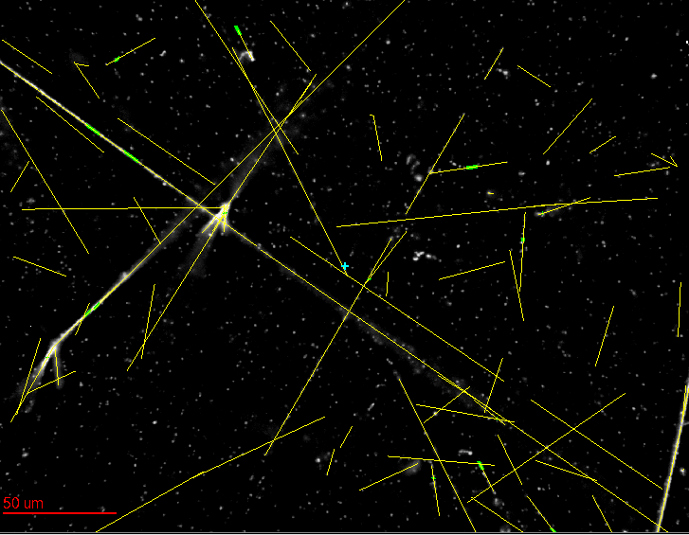
Example of a view (SEE DISPLAY)
all tracks recognized by Aki are reconstructed as well by the algo.

Slide 13
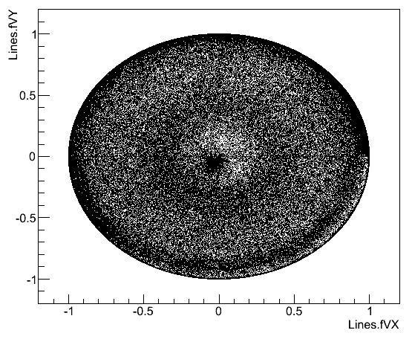
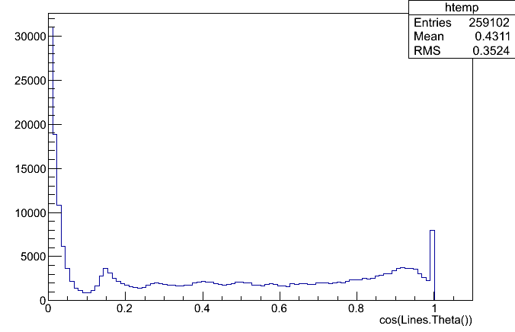
Reconstructed angular distributions
AEgIS film exposed to antiprotons
Angle as 3D unit vector
VX-VY
Cosθ distribution
θ : azimuthal angle
Horizontal
Vertical
tanθ=3
The tracking covers 4 π solid angle

Slide 14
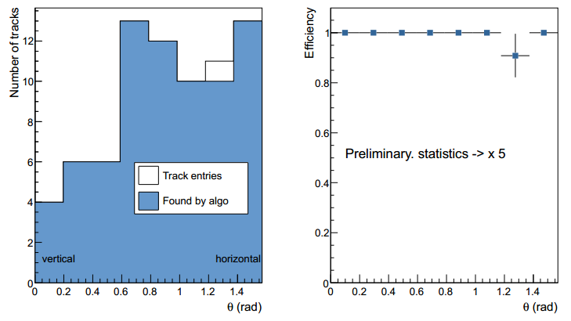
Efficiency of tracking
Efficiency has been checked by comparing unbiased manual measurement
  Tracks longer than 10 microns.
  Half of tracks are heavily ionizing particles
High tracking efficiency is achieved.

Slide 15
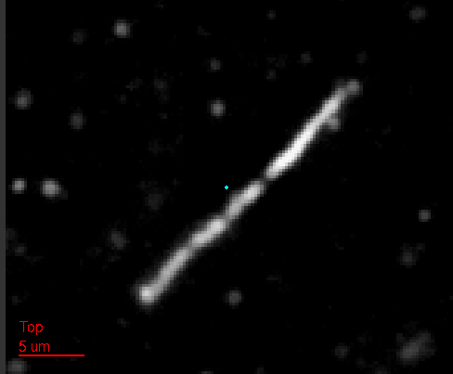
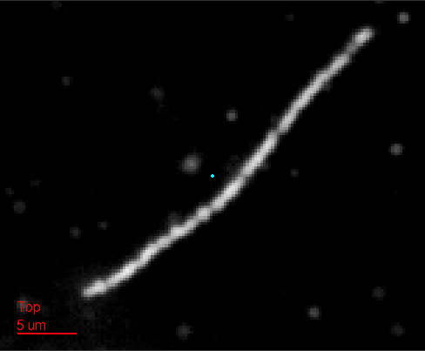
Example of proton tracks recoiled by neutrons
Proton tracks by 2.5 MeV neutrons.
(horizontal tracks are chosen for demo)
Short tracks are reconstructed with start/stop point
A 30 micron short track is reconstructed
A scattered track is reconstructed as 2 segments

Slide 16
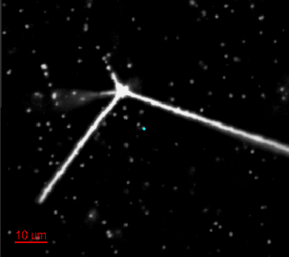
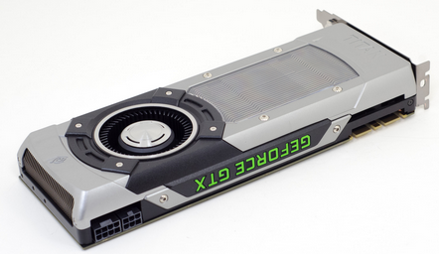
Reconstruction of emulsion data
Goal of processing time = 0.2 sec/view (→ ~10 cm²/microscope)
  Typical data unit “view” = 1280 x 1024 pixels x 40 frames = 52 Mbyte
  FOV = 300x250 microns
  image filtering, 3D grain recognition, 3D track reconstruction
With single thread programming
~10 sec/view with high spec CPU.
need factor 50 times faster processing
→ Track reconstruction based on
GPU technology
  GPU = Graphic Processing Unit
  Advantage : Parallel processing with
  thousands of processing unit
Filter image → grain recognition → Track reconstruction
Notes:
V1293
3D reconstruction of large size of data
20cm x 20cm x 80μm area will be digitized by 0.25μm x 0.25μm x 2μm voxel
30 Tbyte / 20cm x 20cm to be processed within a day or so … need real time process!

Slide 17
Use of GPU, as far as I concerned
In 2003, use of GPU shaders for tracking
  Use of alpha blending for tracking
  Not enough speed… gave up
In 2006, CUDA library has been released by NVIDIA
  General purpose library
In 2008, restarting to use GPUs
  Suggestion to use GPU to the OPERA collaboration → a few successful implementation. See T. Fukuda, V. Tioukov
After several interruptions, achieved a reasonable result recently

Slide 18
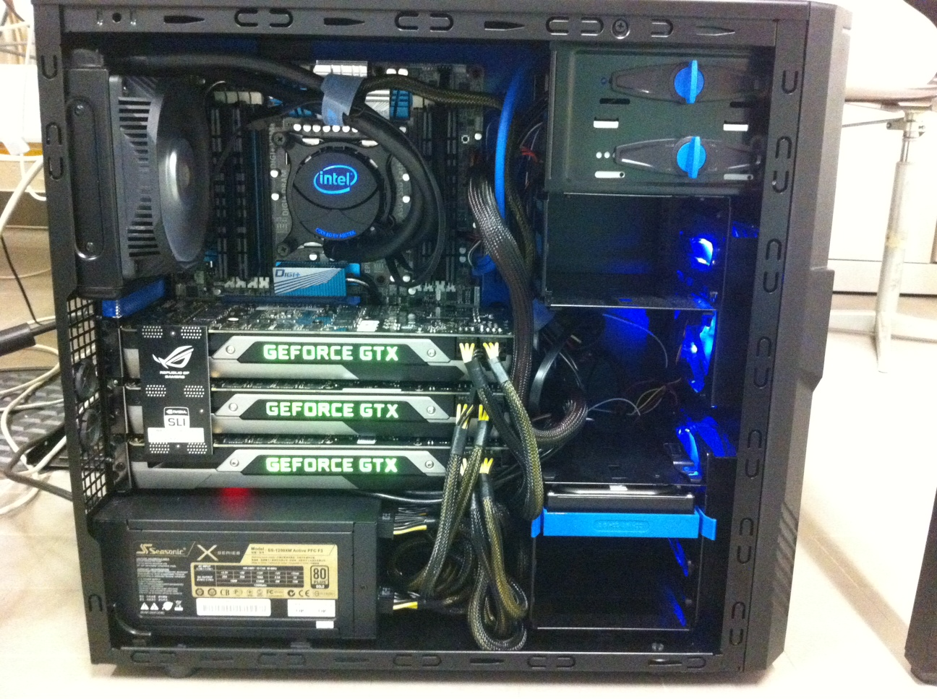
Processing machine equipped with 3 GPUs
Fast memory
DDR3 2400, 16GB
i7- 3930K
6 cores
12 threads
3.2 GHz
Water cooling
Geforece GTX TITAN x 3
2688 cores, 6GB memory, 4.5 TFLOPs in each
Strong power supply
1250 W

Slide 19
Processing time by single thread
Goal: 0.2 sec/view
Same algorithm was implemented on CPU and GPU program.
 | 1 CPU (sec/view) | using 1 GPU (sec/view) | Gain
Image filtering | 0.55 | 0.022 | x25
3D grain reco | 0.20 | 0.025 | x8
3D tracking | 5.90 | 0.373 | x16
i7- 3930K 6 cores, 12 threads, 3.2 GHz
Geforce GTX TITAN, 2688 cuda cores
Filter image → grain recognition → Track reconstruction
Single-CPU-thread and single-GPU is not enough to achieve the goal.
→ Multi-CPU-thread and multi-GPU programing

Slide 20
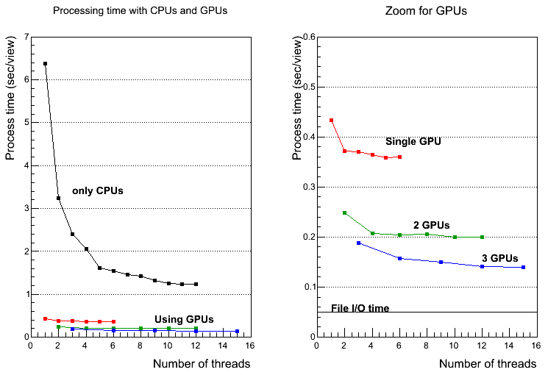
Processing time with “multithreading” and “multi-GPUs “
(mean of 60 views)
Factor 70 faster!
goal
0.2 sec/view
Multithreading x multi-GPUs allow to reduce tracking time factor 70.
CPU :i7- 3930K 6 cores, 12 threads, 3.2 GHz, GPU : Geforce GTX TITAN, 2688 cuda cores

Slide 21
Summary
A new framework for general purpose emulsion scanning/reconstruction is being developed in LHEP Bern
  From data taking to display
Fast 4π tracking is realized with GPU with a reasonable processing time
  0.14 sec/view, even with a factor 100 more computation than the OPERA algo.
  >10cm²/h
The system is being applied to AEgIS, neutron projects and the other applications
Further improvement in processing speed and tracking performance are expected.

Slide 22
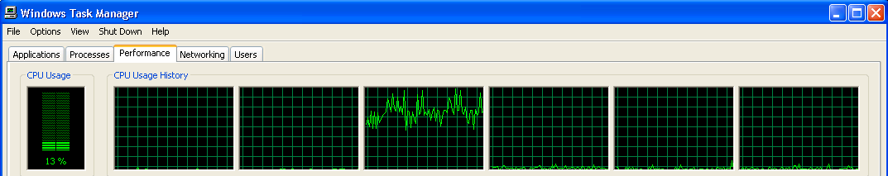
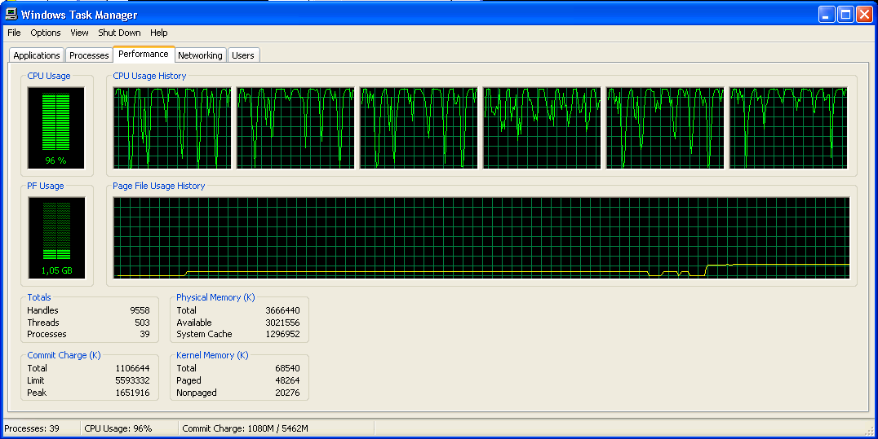
Multi-thread processing
Single process
Multi-thread

Slide 23
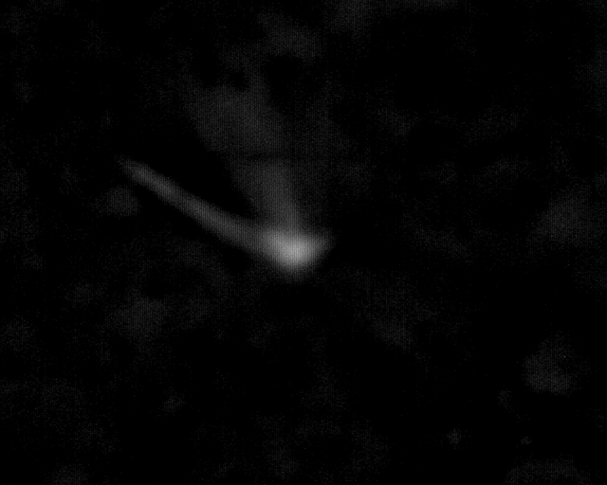
Antiproton annihilation in the emulsion
AEgIS commissioning run (2012)
antiproton
Focus
Emulsion layer
(50 micron)
Glass base
1 mm
Emulsion layer
(50 micron)
200 microns
Notes:
C:\Users\ariga\prg\LHEPMic6\work\AEgIS_G1

